Slide 1
Analysis of Viennese Traffic Counts
FINAL PRESENTATION
Michael Bösch
Paul Ladstätter
Anna Macalik
Margaritha Wanker

Slide 2
AGENDA
Traffic Heatmap Analysis
Covid19 Analysis
Cluster
Public Transportation ~ Traffic Count
Traffic Trends - City Centre vs. Suburbs
Forecasting
Visualization Dashboard

Slide 3
GOALS OF THIS PROJECT
F
Traffic Heatmap Analysis
Cluster Analysis
Forecasts
Dashboard

Slide 4
DATASETS
Permanent counting points
Public transportation infrastructure
Population data
Covid19 data

Slide 5
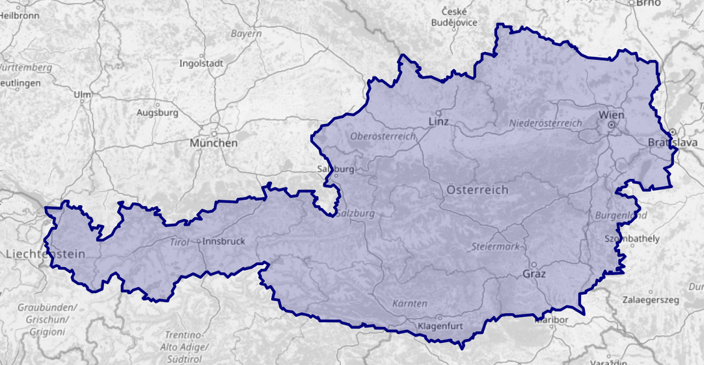
OPEN STREET MAP DATASET
Extracted Vienna from the OSM Austria dataset
Extracted the stop positions of the public transportation
Combined the permanent count points with the public transportation within a radius of 1 km
Extracted entities:
Subway
Tram
Train
Bus
LINK: HTTPS://OSM-BOUNDARIES.COM/MAP

Slide 6
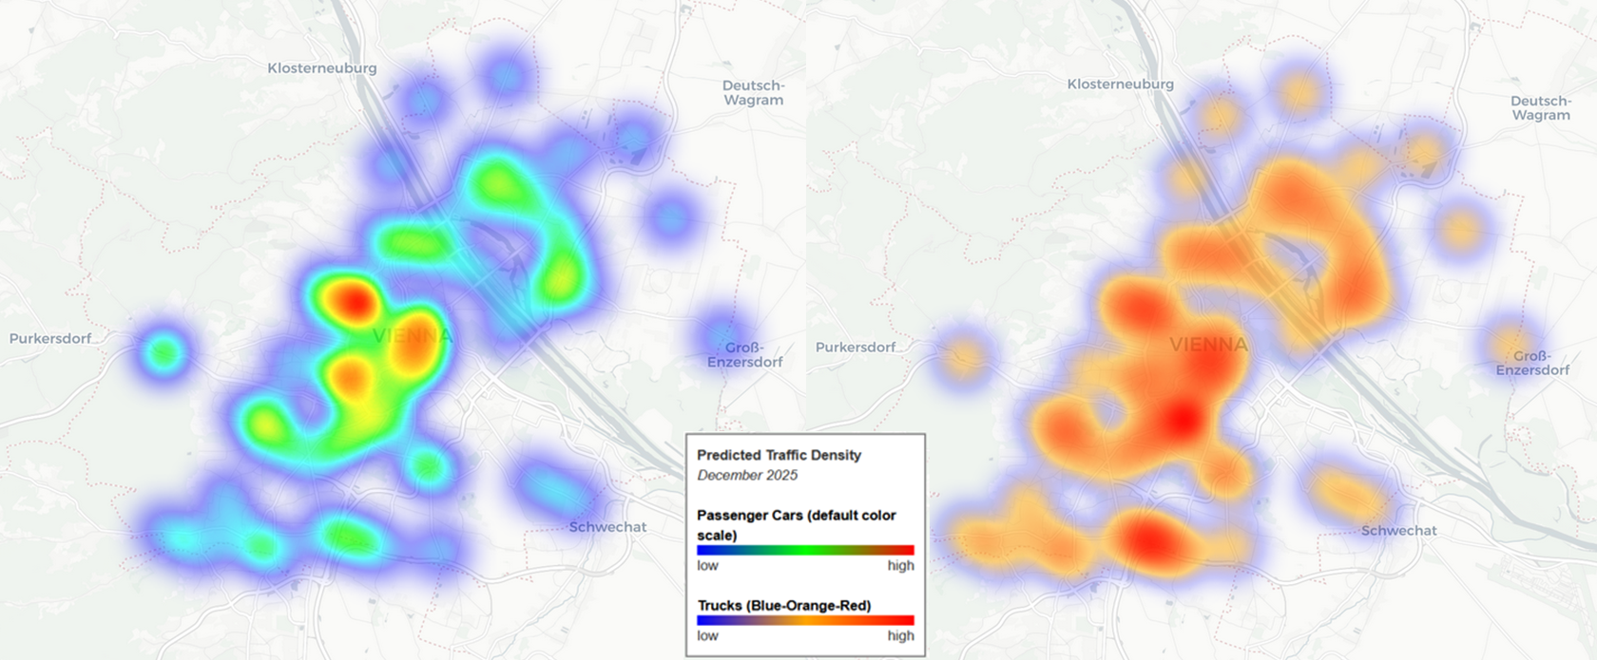
TRAFFIC HEATMAP ANALYSIS

Slide 7
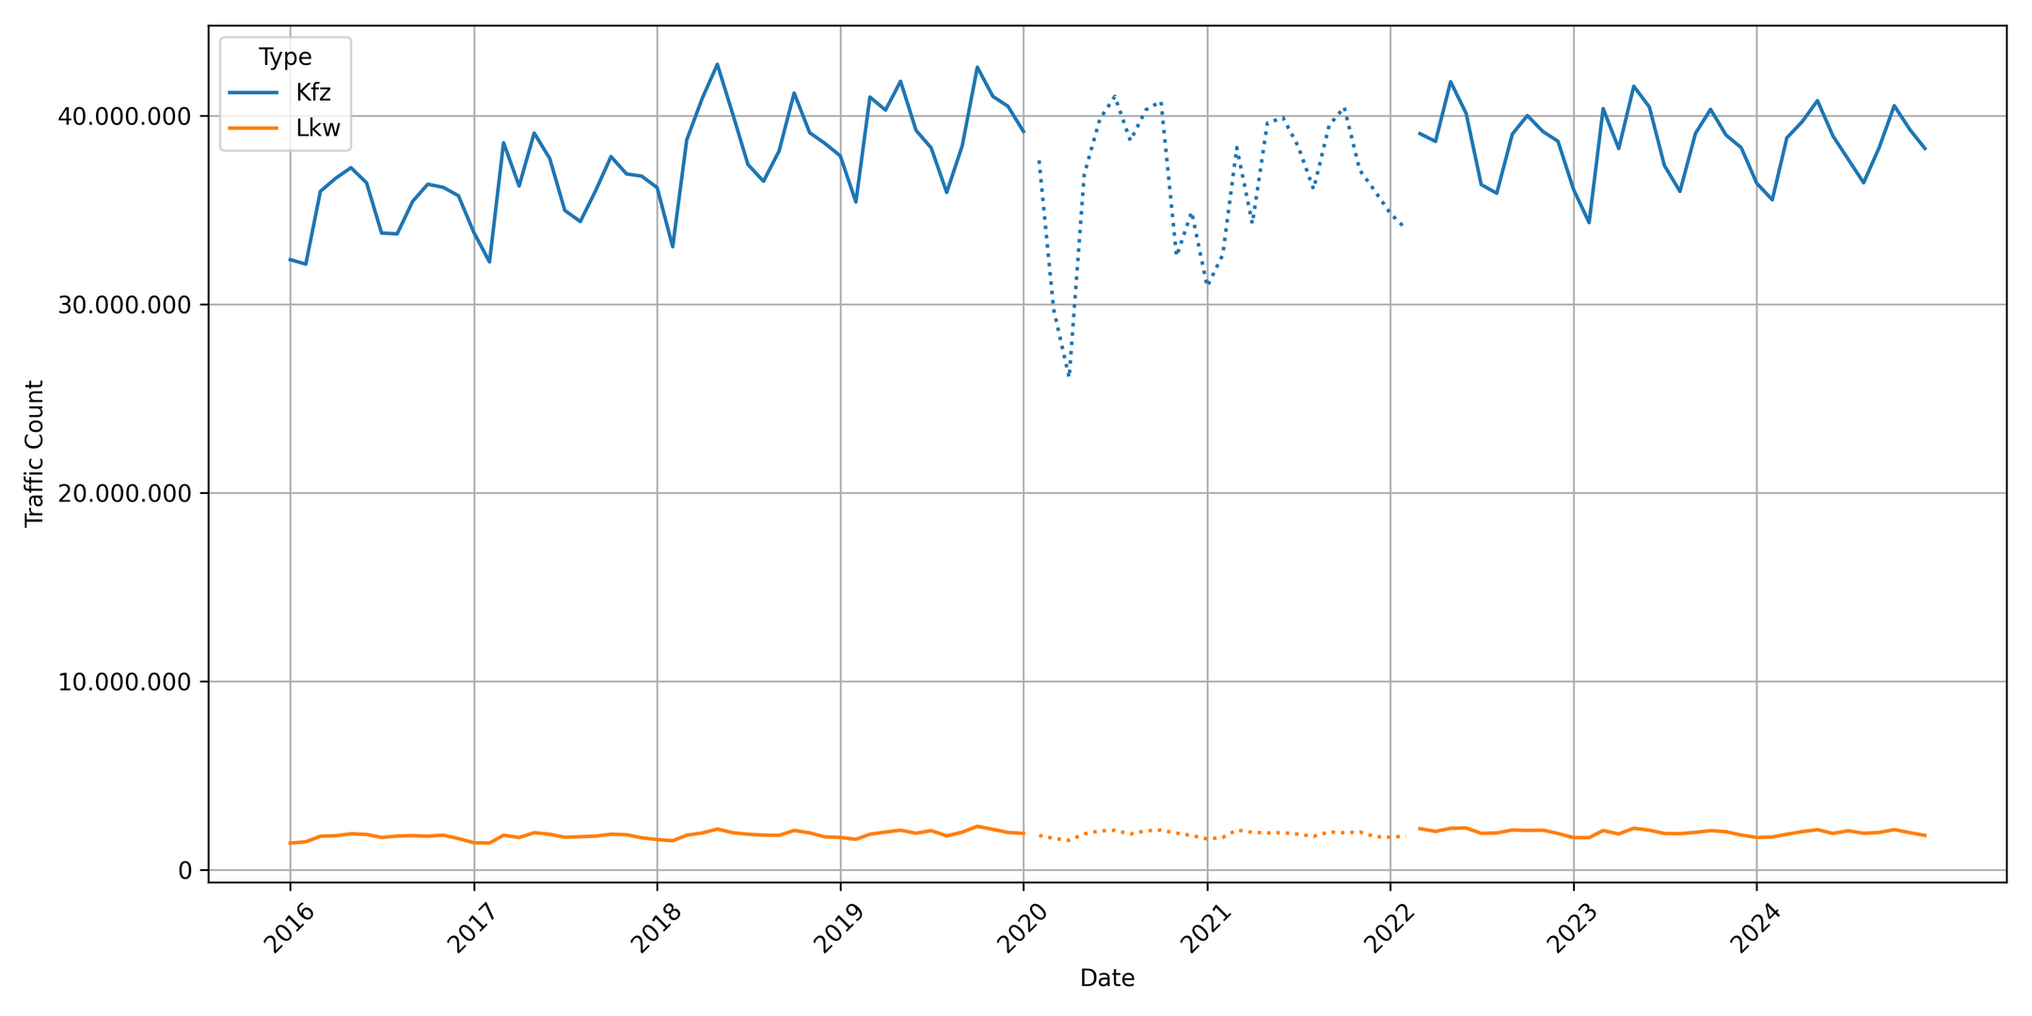
COVID19 HISTORIC ANALYSIS TVMAX

Slide 8
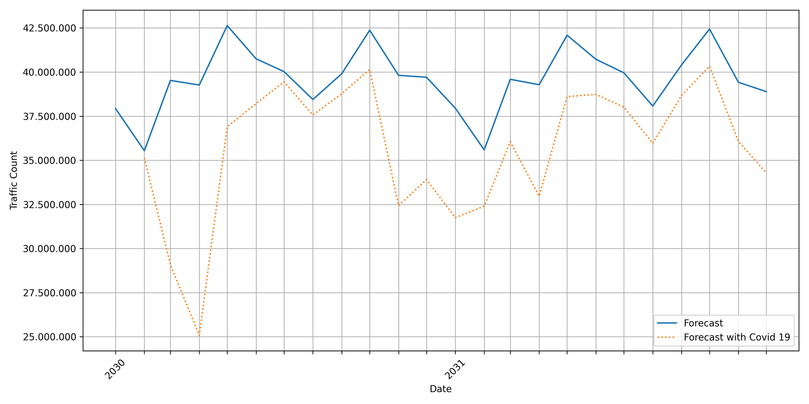
COVID19 FORECAST CARS 2030 - 2032 DTV

Slide 9
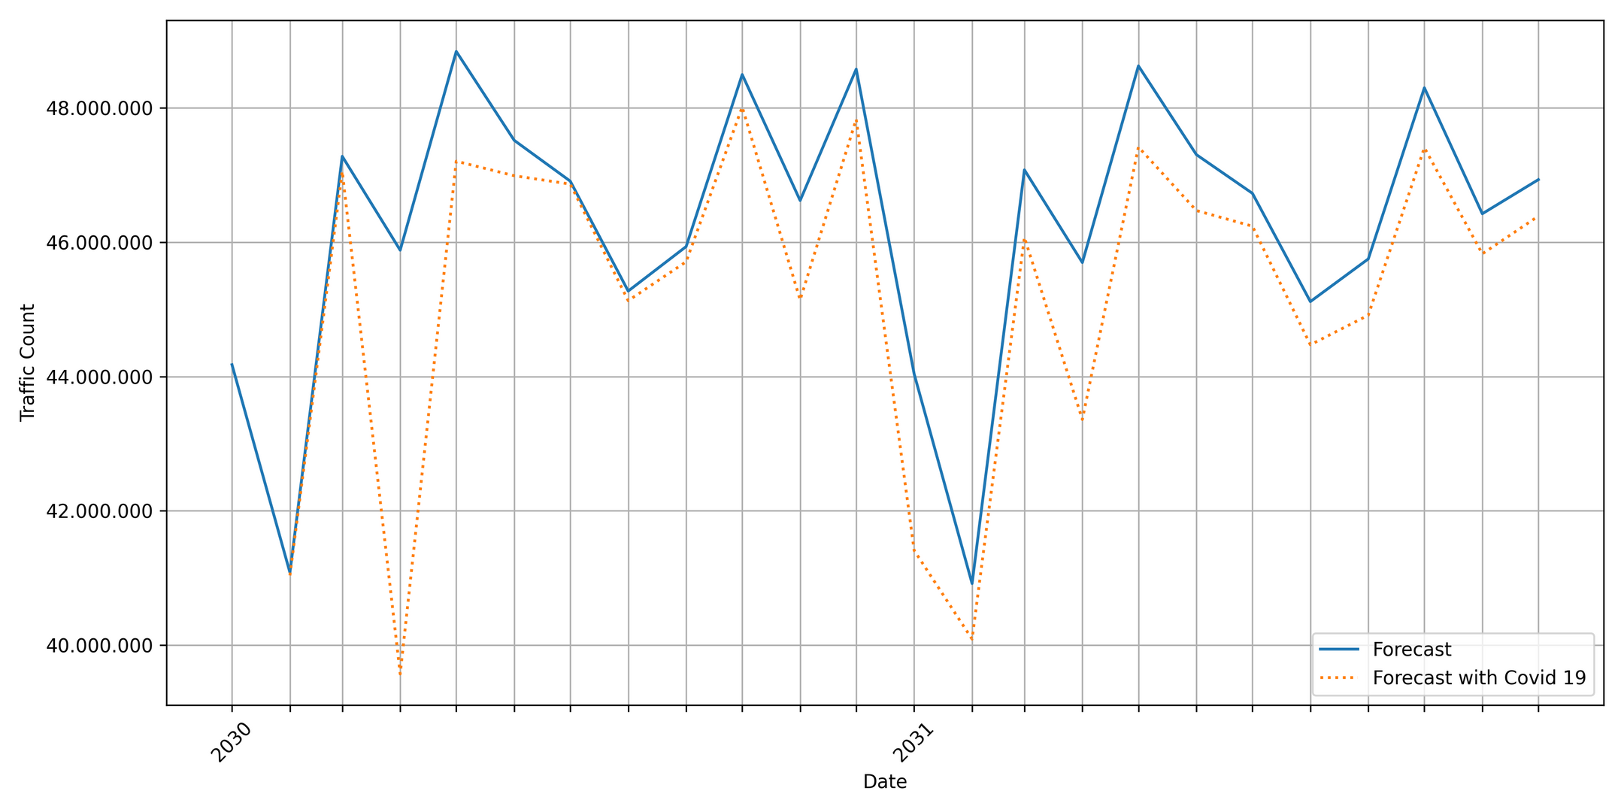
COVID19 FORECAST CARS 2030 - 2032 TVMAX

Slide 10
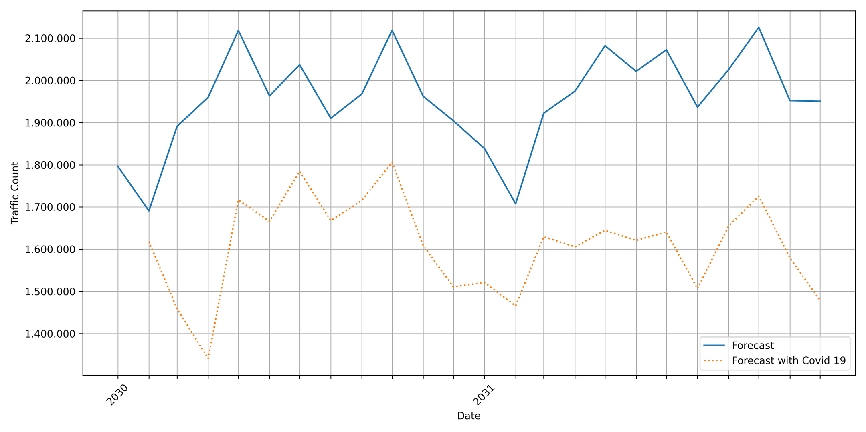
COVID19 FORECAST TRUCK 2030 - 2032 DTV

Slide 11
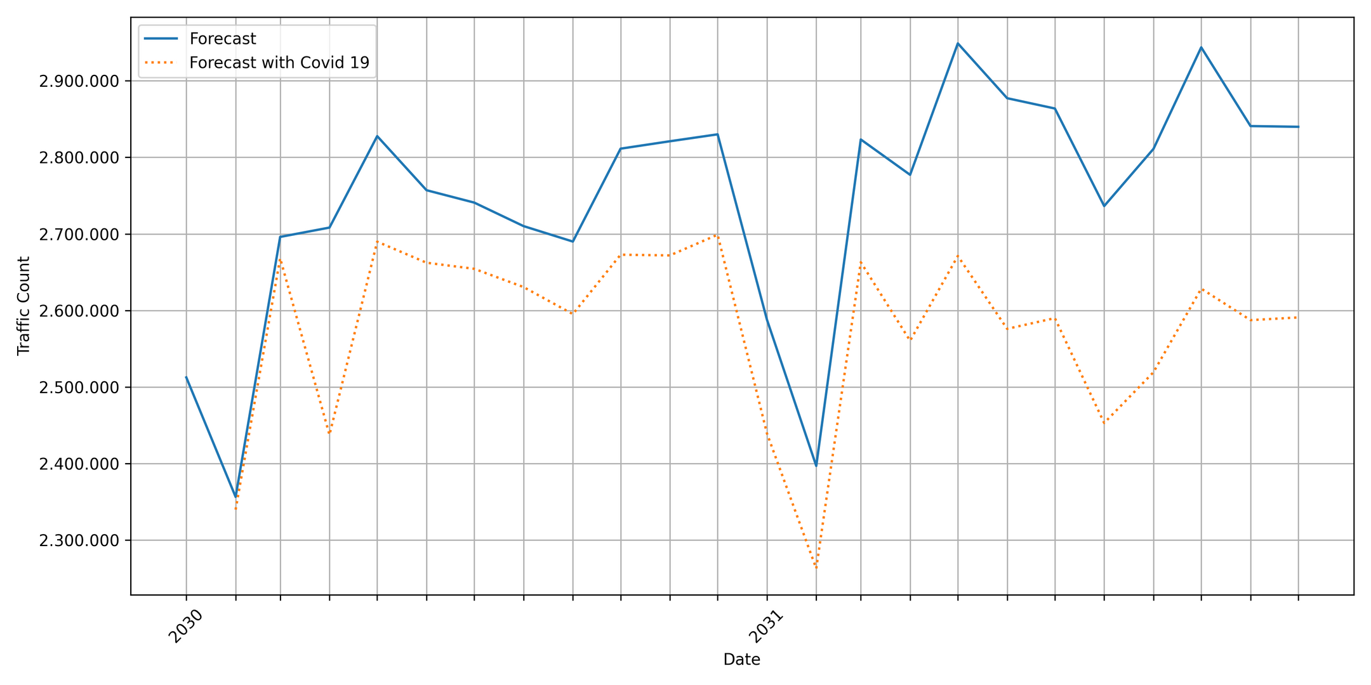
COVID19 FORECAST TRUCK 2030 - 2032 TVMAX

Slide 12
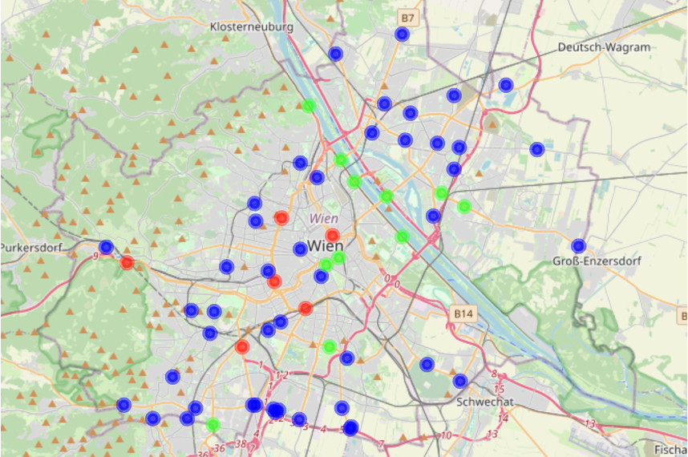
CLUSTER ANALYSIS CARS MON - SUN
RED - HIGH
GREEN - MEDIUM
BLUE - LOW

Slide 13
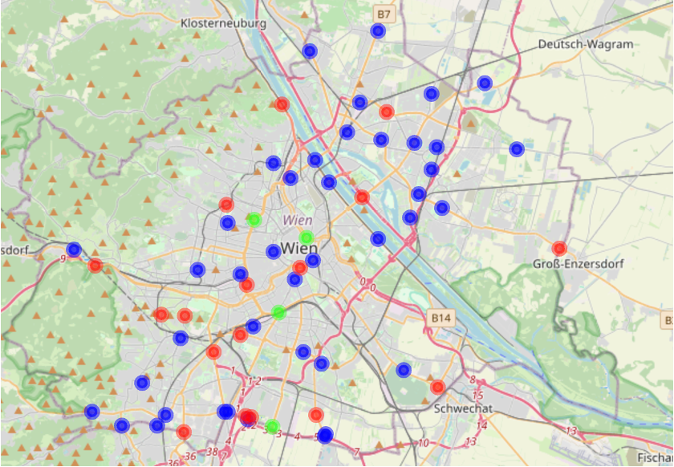
CLUSTER ANALYSIS TRUCKS MON- SUN

Slide 14
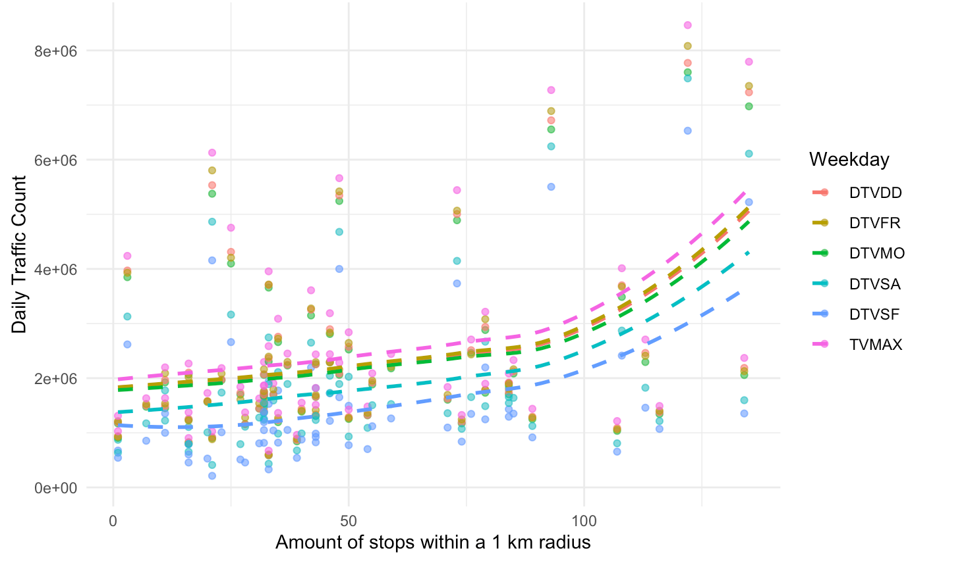
ANALYSIS PUBLIC TRANSPORTATION

Slide 15
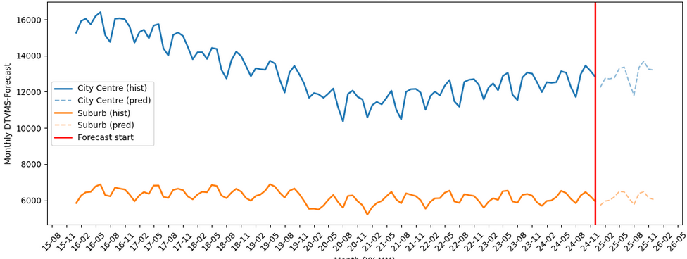
TRAFFIC-FORECASTS: CITY CENTRE VS SUBURBS

Slide 16
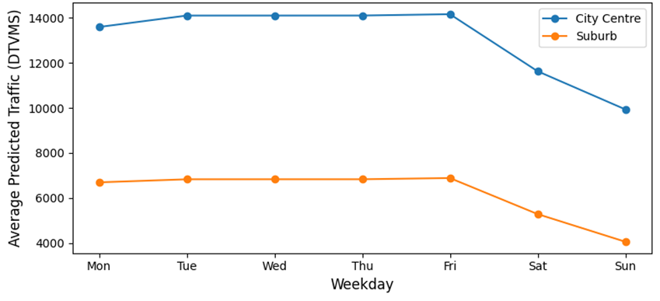
AVERAGE WEEKLY TREND

Slide 17
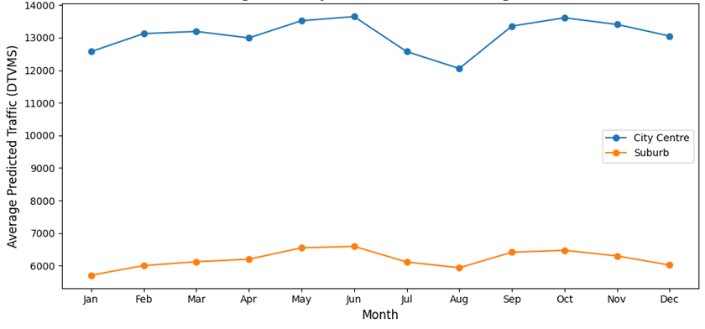
AVERAGE MONTHLY TRENDS

Slide 18
DATA FOR THE DASHBOARD
Traffic Counts
Average daily car traffic volume from January 2016 to December 2024.
Exogenous Variables
Commuter Rate
Vehicles per 1000 inhabitants
Population
City-wide transportation mode split
Arima Forecasts
until December 2030

Slide 19
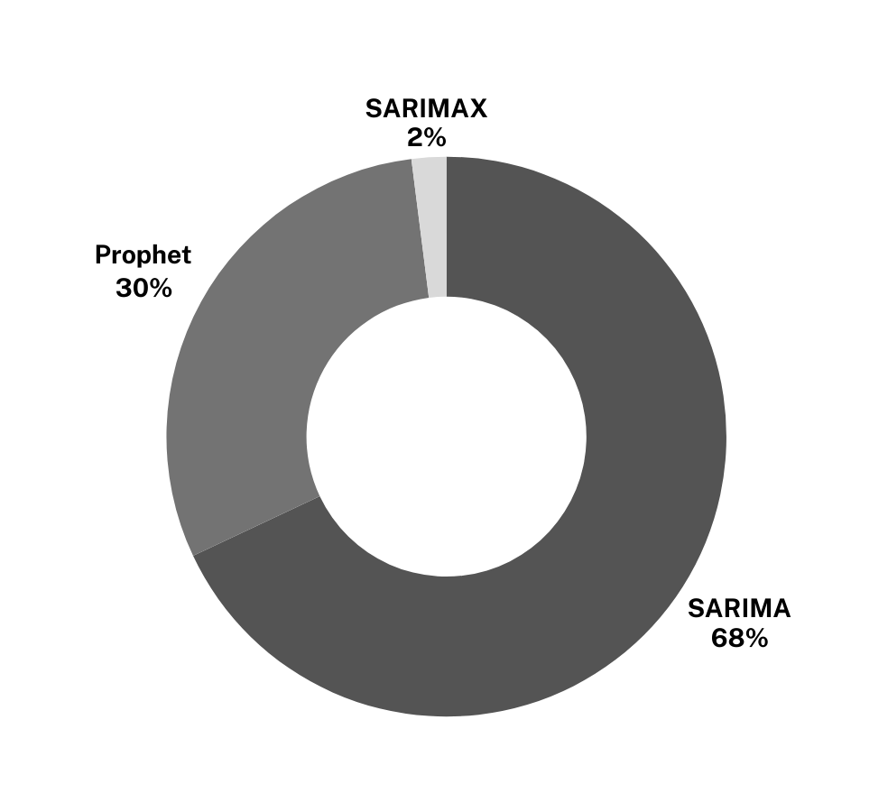
FORECASTS FOR THE DASHBOARD
Multi Model Strategy
Prophet: Facebook’s Time Series Model
SARIMA: Classic Time Series Model
SARIMAX: Addition of External Variables
Accuraccy & Weighting
Backtested each model on 2 year period (2023-2024) and compared to real data.
Performance weighted ensemble forecasts.
Combines strengths of each model.

Slide 20
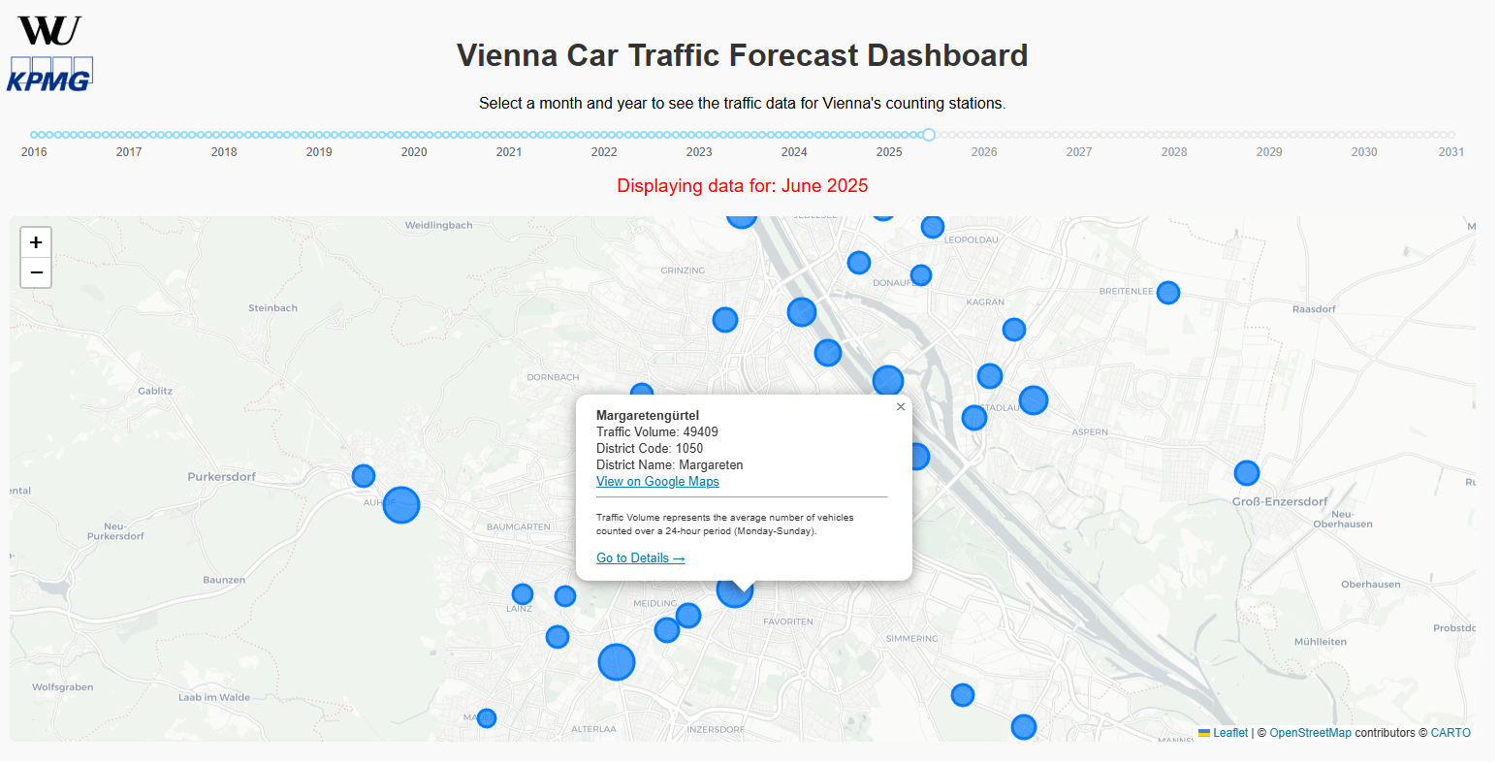
MAIN VIEW: VIENNA TRAFFIC MAP

Slide 21
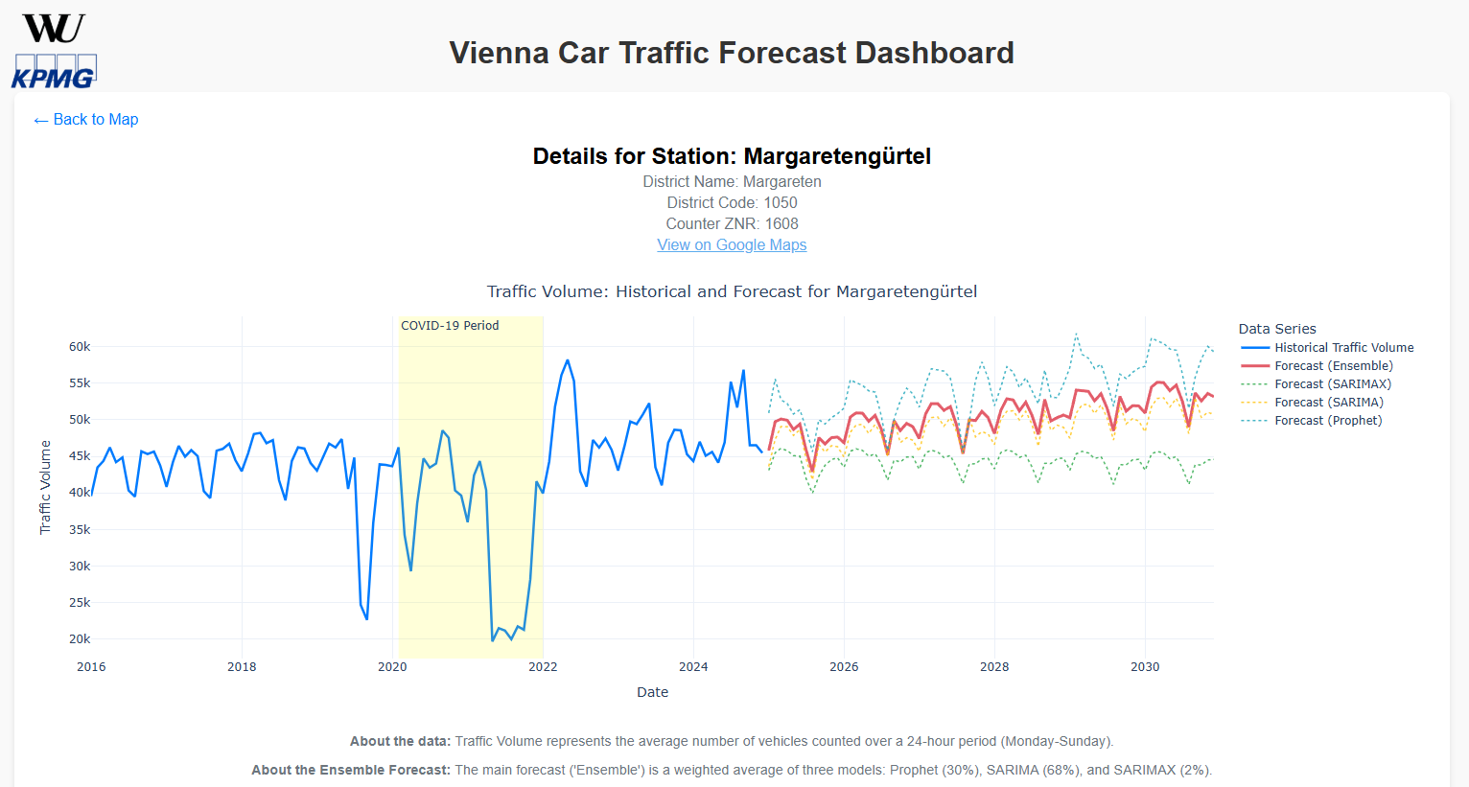
DETAILED VIEW: TRAFFIC FORECASTS

Slide 22
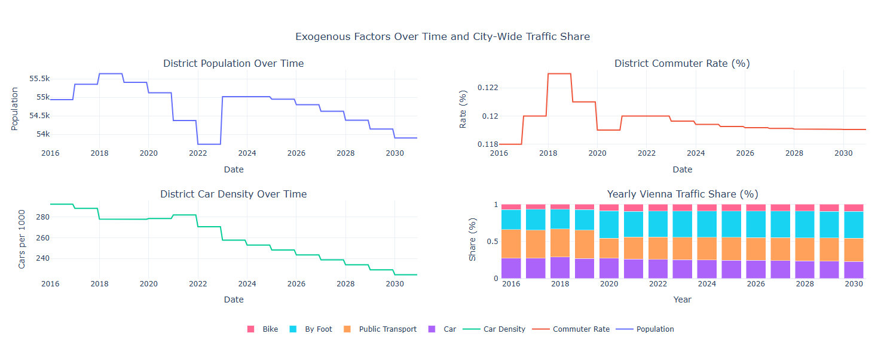
DETAILED VIEW: THE WHY

Slide 23
